Slide 1
WELCOME TO
OUR CLASS 5A4
Teacher: Le Thi Trang
School: Nguyen Tba Ngoc primary school

Slide 2
Let’s chant: BANANA

Slide 3
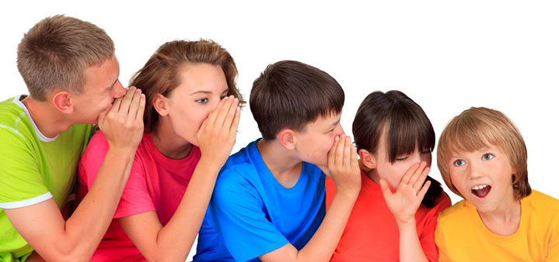
Let’s play game: whispering

Slide 4
Thursday, December 12th, 2019
Unit 10: When will sports Day be ?
Lesson 3 - Part 1, 2, 3 (Page 68)
1. Listen and repeat.
2. Listen and underlined the stressed words. Then say the sentences aloud.
3. Let’s chant.

Slide 5
Thursday, December 12th , 2019
Unit 10: When will Sports Day be?
Lesson 3: 1,2,3
1. Listen and repeat.
'
'
'
'
When will Sports Day be?
'
It’ll be on Saturday.
'
'
'
'
'
What are you going to do on Sports Day?
'
'
'
I’m going to play football.

Slide 6
Thursday, December 12th ,2019
Unit 10: When will Sports Day be?
Lesson 3: 1,2,3
2. Listen and underlined the stressed words. Then say the sentences aloud.
A: When will Sports Day be?
B: It’ll be on Sunday.
2. A: What are you going to do on Sports Day?
B: I’m going to play table tennis.

Slide 7
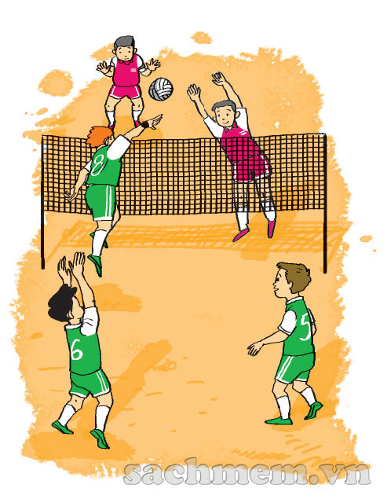
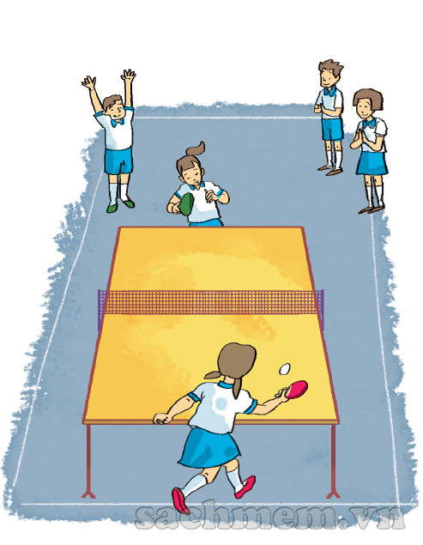
Thursday, December 12th , 2019
Unit 10: When will Sports Day be?
Lesson 3: 1,2,3
3. Let’s chant.
What are they going to do?
Sports Day will be this weekend.
It’ll be this weekend.
What are they going to do?
They’re going to play volleyball.
They’re going to play table tennis.
They are practising hard
For Sports Day.

